Slide 1
Module 7.2: The Alibaba Display Problem
Dennis J. Zhang
Washington University in St. Louis
Based on the paper “Taking Assortment Optimization from Theory to Practice:
Evidence from Large Field Experiments on Alibaba”

Slide 2
Taking Assortment Optimization from Theory to Practice: Evidence from Large Field Experiments on Alibaba
Dennis J. Zhang
Washington University in St. Louis
Georgia Tech Scheller College of Business, October 2018
Jake Feldman
Washington University in St. Louis
The engineering team at
Alibaba

Slide 3

A “live” demo
This is a “live” demo on the display problem on Alibaba, using the best ramen seller, IMHO, in China

Slide 4
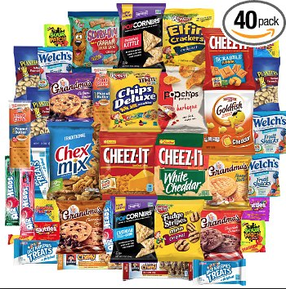


The Alibaba Product Display Setting
~ 250,000 Daily Active Sellers
100 – 300 Products
300 – 1000 Products
150 – 400 Products
Number of visits per day: 4 million
Revenue per day: 19.6 million RMB (3.1 million USD)
Annual Revenue: ~7 billion RMB (~1 Billion USD)

Slide 5





The Alibaba Product Display Problem

Slide 6


The Current Practice – Machine Learning
Product Features (e.g.)
Price
Seller ID
Category
Launch Date
Customer Features (e.g.)
Age
Gender
Device
Historical purchases/clicks
Joint Features through Collaborative Filtering
Machine Learning
Black Box

Slide 7
The Current Practice – Machine Learning
All of these have to be done within 50 milliseconds

Slide 8
ML Approach – Pros and Cons
Pros:
Powerful machinery to estimate probabilities
Simple accompanying optimization problem
Cons:
Doesn’t account for substitution behavior
Hard to interpret
Research Question: Can we do better by viewing this problem through an operations and economics perspective?
Use customer choice models to capture substitutions
Solve assortment optimization problems to find optimal set to offer.

Slide 9
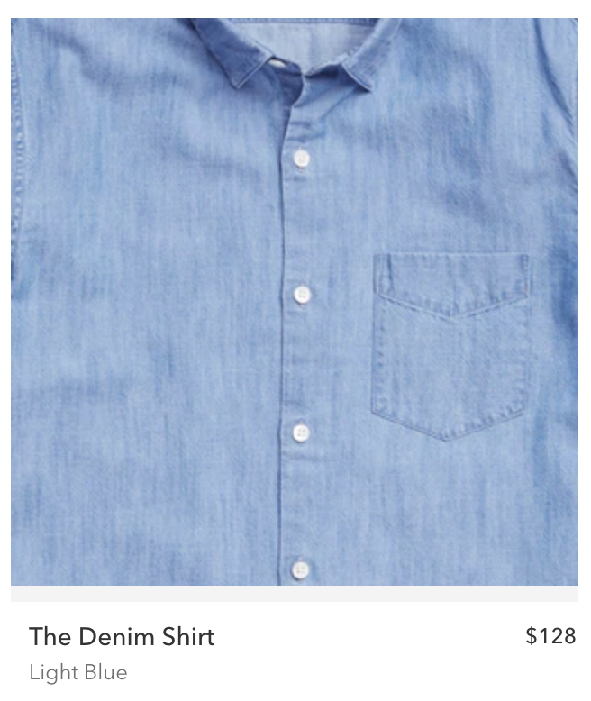

Why does substitution matter (intuitively)?
$128
$78
Consider the following two almost identical shirts from Bonobos
Suppose you have two slots, how do you recommend products?
Without substitution, you will recommend both since all of them generate non-negative revenue.
With substation, you may want to strategically hide the $78 one.
Substitution-based models leads to higher revenue per item (in theory).
ML
With substitution
$128
$128
$78

Slide 10

Customer Choice Models

Slide 11
Multinomial Logit Choice Model
Deterministic and feature-based
Random iid Gumbel error
vector of features
How to find the coefficients? MLE is convex.

Slide 12
Estimating MNL – Historical Data

Slide 13
Estimating MNL – MLE
Difficulties in Estimation:
Data Size (10 TB+ Training Data): A customized TensorFlow-based implementation of MNL
What features to use (10 million variables): Top 25 features (300+ variables) in ML model
No-purchase events (false clicking): Data cleaning + down-sampling no-purchase events
IIA: Pass the Hausman-McFadden tests in this context.*
Cheng and Long (2007)

Slide 14
Optimization based on Estimated MNL
The difficult part is not estimation but optimization.
Why?
Even if we have a choice-model it is unclear how we can select 6 (or 10) products out of 1000 efficiently.
This optimization problem is by nature combinatorial.
This optimization problem has to be done online (under 50 milliseconds) to not trigger 404.

Slide 15
Optimization based on Estimated MNL
Our updated algorithm:

Slide 16
Optimization based on Estimated MNL
Finding the optimal set to display
Finding the unique fixed point for f(z)

Slide 17
Cardinality Constrained Assortment Problem
Let us assume there are 3 products (N = 3) and 2 display slots (|x| = 2):
Value
Region 1
Region 2
Region 3
How many possible regions are there?
z

Slide 18
Cardinality Constrained Assortment Problem
Let us assume there are 3 products (N = 3) and 2 display slots (|x| = 2):
Value
Simple Algorithm (Sorting):
Find all intersections.
Sort all intersection points.
Going through all intersection regions to find the optimal z and ordering (i.e., assortment).
z

Slide 19
Cardinality Constrained Assortment Problem
Let us assume there are 3 products (N = 3) and 2 display slots (|x| = 2):
Value
Our Algorithm (Bisection):
Initialize min = 0 and max = inf.
Find all intersections between (min, max).
(Terminal Condition) If we have 2 or 1 intersections, solve the optimal ordering between these intersections, and terminate.
Find the median of all intersections at z
(Repeat Condition) Find the optimal ordering at z. If f(z) > z, set min = z. Otherwise, set max = z.
Repeat from Step 2.
z

Slide 20
MNL-based Approach – Pros and Cons
Pros:
Incorporate substitution behaviors
Grounded in economics theory to reduce search space
Cons:
Harder to interpret the click behavior
The estimation has rigid functional form and is difficult to scale (less a problem under MNL)
Let us use a large field experiment to test which one is better!

Slide 21
The Experiment Set-up
The experiment timeline (one week): 03/12/2018 – 03/18/2018
Customers (upon arrival) are randomly assigned to 3 buckets:
ML Approach:
ML approach with 25 top features (300+ variables)
ML approach with all features
MNL Approach:
MNL approach with 25 top features (300+ variables)
Randomization is based on the last digit of an experimental hash of customer id

Slide 22

Data
249,856 sellers in the sample period
15,034,273 customers in the sample period
27,815,483 unique page views in the sample period
Actions:
3,263,813 clicks on items
671,137 purchased items
137,380,781 RMB in revenue (i.e., $21.7 million)

Slide 23
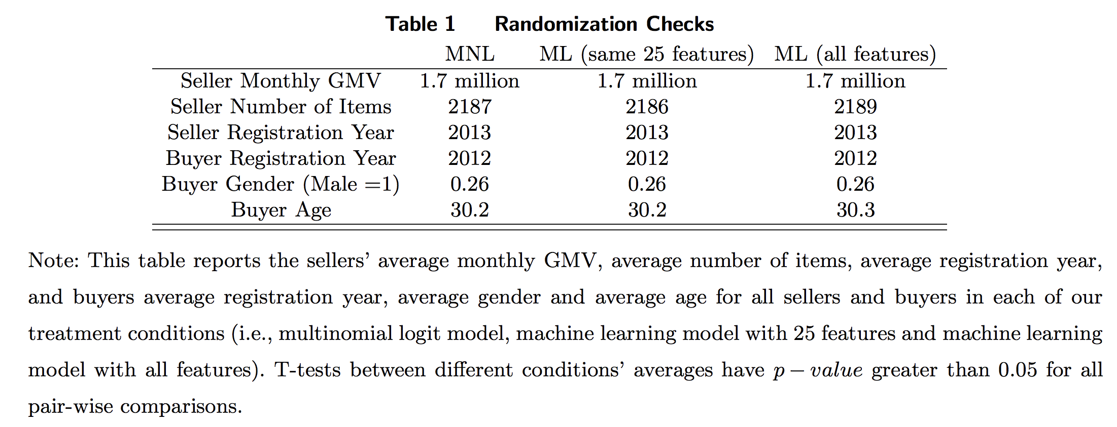
Randomization Check
Customers and buyers in each bucket have statistically similar characteristics:

Slide 24
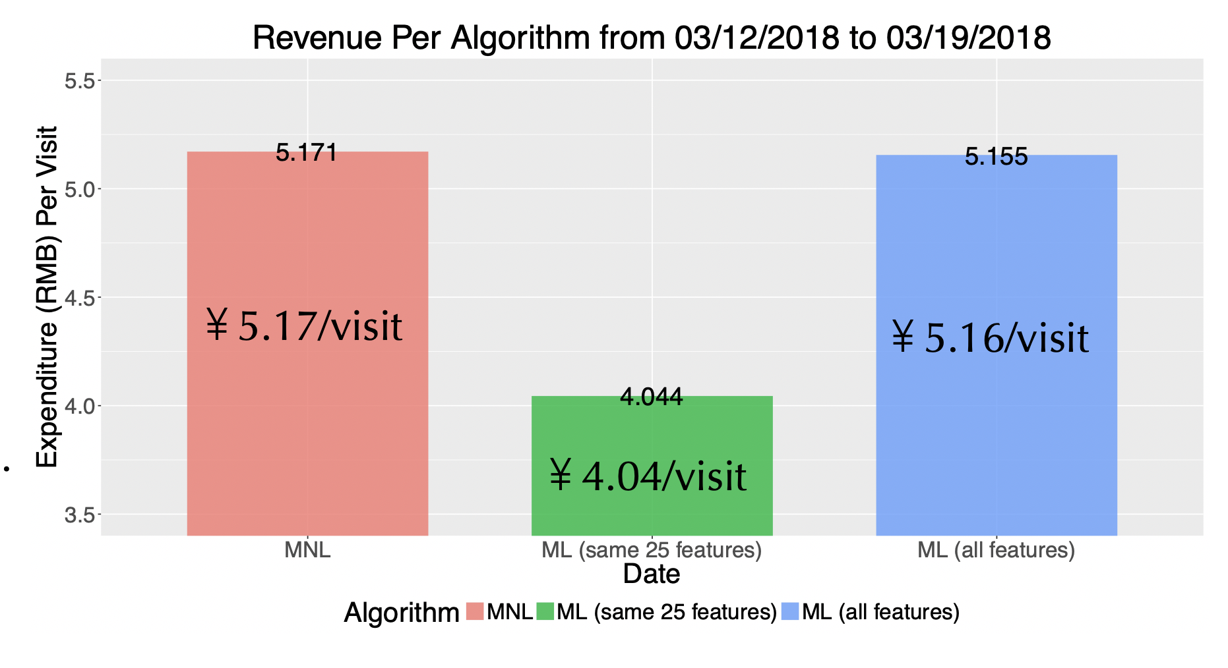
Model Performance on Expenditure
28% improvement over ML algorithm with the same features.
0.3% improvement over all-feature MNL.
Not statistically significant for now

Slide 25
Robustness: Daily Revenue Performance

Slide 26
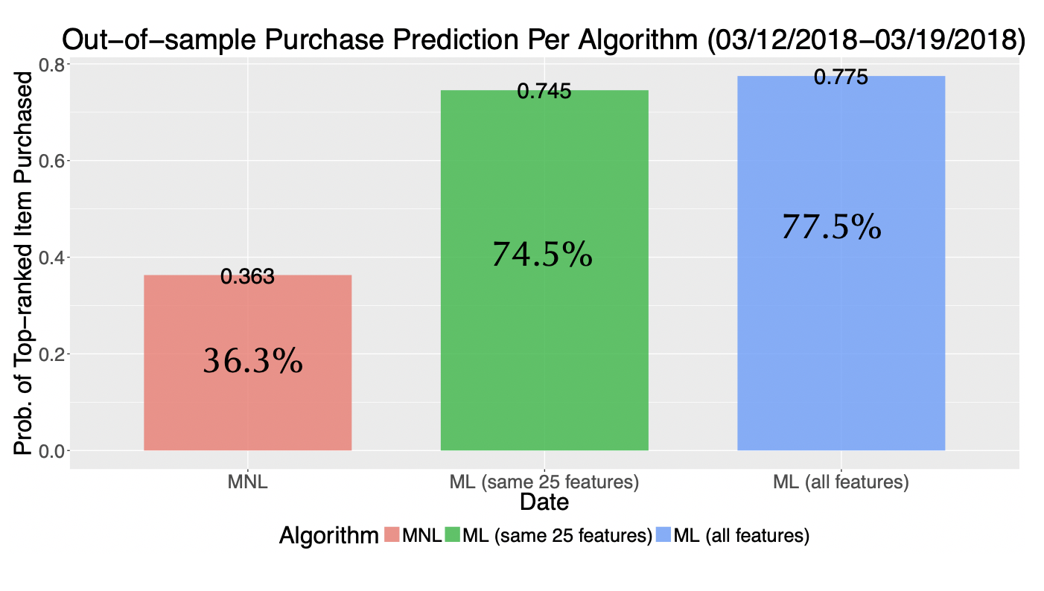
Model “Prediction Accuracy” on Purchases
The percentage of the purchased item in an offer set is the top-ranked item by the algorithm.
utility in MNL
purchasing probability in ML

Slide 27
Robustness: Daily Prediction Performance

Slide 28
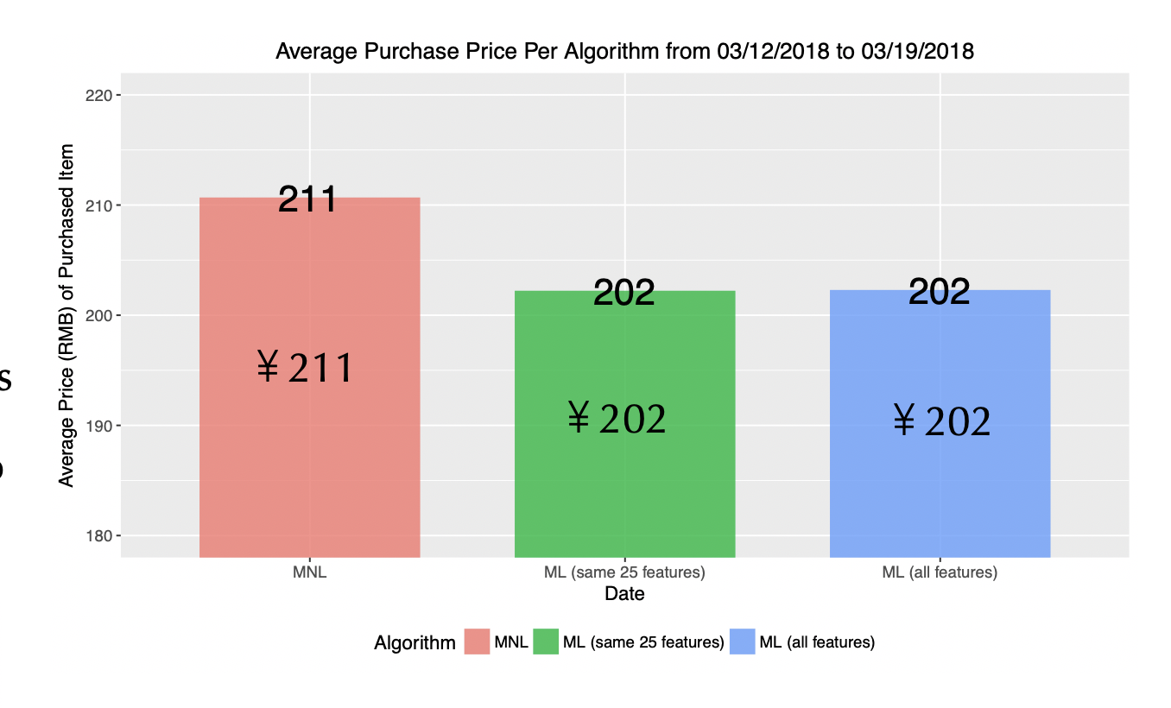
Possible Mechanism: why are we doing better?
It seems that the hypothetical drawback of ML approach is true
MNL model generates 5% higher revenue per item compared to the MLa approaches.
$128
$78

Slide 29
Long-term impact of our algorithm
While we are recommending “more expensive” products, does this scare away our customers in the long-run?
For customers who were affected in March, 2018, we focus on their behaviors from 07/01/2018 to 07/31/2018.
￥1,436
￥1,431
93.3%
93.3%

Slide 30
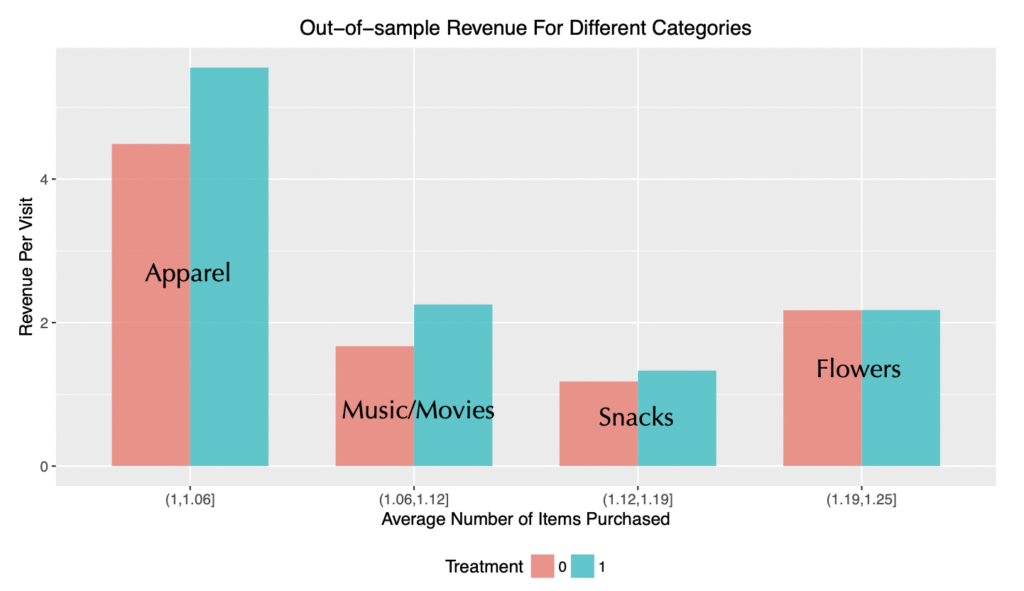
Potential Improvement: Multiple Purchases
MNL Algorithm’s relative performance decreases as number of purchases increases per visit.

Slide 31
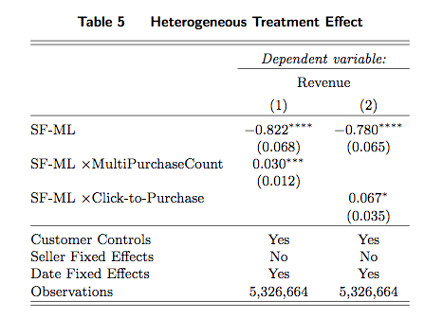
Potential Improvement: Multiple Clicks
The relative performance improvement of the MNL algorithm versus ML algorithm decreases with respect to click to purchase ratio

Slide 32
Full-feature MNL vs. Full-feature ML
We launched the full-featured MNL-based model on September 22, 2018.
We are debugging the system…
The all-feature MNL model has 2.17% improvement in GMV per visit.
~28.73 million dollars per year.
￥4.59/visit
￥4.69/visit

Slide 33
Summary
We develop a MNL-based recommender system with cardinality constraints.
We conducted a large field experiment on Alibaba to demonstrate that this MNL-based system out-performs the state-of-art ML-based system:
We show that some benefit from substitution comes from the higher revenue per item.
We demonstrate the potential improvement area of current choice-model-based revenue management tools.

Slide 34
Alibaba’s Reaction and Future Work
Alibaba’s reaction:
Implement this MNL with all the features (an engineer team of 6 people).
Utilize this method to more general recommendation (front-page of Taobao.com and Tmall.com, 35% of Alibaba’s site traffic)
Future work:
Incorporate click probabilities in a theoretical (and practical) way
Requires a theoretical model on click probabilities.
”Assortment Optimization with Random Consideration Sets: Theory and Evidence from Alibaba,” by Aouad, Feldman, Segev and Zhang.
Deal with multiple purchases in the data in a more theoretical way
Surprisingly difficult due to the fundamental limitation of choice models

Slide 35
Thank you denniszhang@wustl.edu

Slide 36
Cardinality Constrained Assortment Problem

Slide 37
Cardinality Constrained Assortment Problem

Slide 38
Cardinality Constrained Assortment Problem
Proof:

Slide 39
Cardinality Constrained Assortment Problem

Slide 40
Cardinality Constrained Assortment Problem
Q.E.D

Slide 41
Cardinality Constrained Assortment Problem
For each given z, we can find top C products.
We need to find the largest fixed point z.

Slide 42
Cardinality Constrained Assortment Problem
Simple Algorithm:
Find all intersections.
Sort all intersection points.
Going through all intersection regions to find the optimal z and ordering (i.e., assortment).
What is the time complexity?

Slide 43
Cardinality Constrained Assortment Problem

Slide 44
Cardinality Constrained Assortment Problem
Simple Algorithm:
Find all intersections.
Sort all intersection points.
Going through all intersection regions to find the optimal z and ordering (i.e., assortment).
What is the time complexity?

Slide 45
Cardinality Constrained Assortment Problem
Our Algorithm:
Initialize min = 0 and max = inf.
Find all intersections between (min, max).
(Terminal Condition) If we have 2 or 1 intersections, solve the optimal ordering between these intersections, and terminate.
Find the median of all intersections at z
(Repeat Condition) Find the optimal ordering at z. If f(z) > z, set min = z. Otherwise, set max = z.
Repeat from Step 2.
What is the time complexity?

